Slide 1


Notes:
Hello, today you will get acquainted with a web application – a store for mobile devices and accessories for them Why online, what is different? History – you are looking for an item, but you do not know all its features; in the first store; many people and goods; He is not there; second store...; A lot of time is wasted. Solution: Provides all the goods of one store "One click away" from the buyer

Slide 2
Project objective
Notes:
A peak to reach to be called "Finalized" Main goal: solving 3 main problems of the modern consumer: 1st problem – The hectic everyday life History (1.5) – You open your laptop and look for such sites...

Slide 3
Language barrier
Notes:
History (2) – The desired item is not on a Bulgarian site and you are looking in others, but you do not understand the language of its content More buyers

Slide 4

Diversity from the resolution
Notes:
History (3) – The site is translated into Bulgarian. You find the desired product and send a link to it to a person who opens it with a phone. But he sees it in a much worse way than you do – everything is messy More buyers 3 problems – insufficient time, language barrier, variety of screens

Slide 5
Stages in development
Notes:
Goal clarified → Steps to achieve it

Slide 6
1
Planning
Notes:
The most important part (1 month) Choosing the right architecture, technologies (ASP.NET, EF Core, SQL, HTML, CSS, JS, Ajax, NMT) and methodology – Agile: dividing project work into parts Database design Logical explanation of functionalities Choosing a design

Slide 7
2
Creating and filling in the database
Notes:
After it is designed, comes its realization Creating the models with public and personal validation attributes and corresponding relationships through the CMO model Migrate to on-premises MSSQL Server and upgrade the base (EF Core – ORM framework) Filling in with test data

Slide 8
3
Building links with the database
Notes:
How the Wikimedia Commons website works from the inside – pressing a button Adding controllers using the Scaffolding technique GET and POST HTTP requests for CRUD operations on tables

Slide 9
4
Built-in protection
Notes:
Not everyone can run CRUD queries to every table Identity libraries → authentication with email, name and password Dividing the site into zones by privilege

Slide 10
5
Add views
Notes:
Presentation of data GUI for interaction with the database

Slide 11
6
Pastiche
Notes:
Decorating web pages

Slide 12
7
Testing
Notes:
Vulnerability and bug detection Troubleshooting User Experience Assessment

Slide 13
8
Repeating
Notes:
Agile methodology (philosophy) – next iteration

Slide 14
Project features
Notes:
Objectives achieved Evaluation of the application so far What Makes This Online Store Competitive

Slide 15
Multi-layer architecture
Solid foundation for development
Notes:
Layered → easy maintenance In case of a problem in one layer, the entire application is not affected

Slide 16
The database
Normal form of Boyce-Code
Notes:
3.5 NF Avoiding anomalies and clutter The most commonly used values are saved in other tables to be called instantaneously, without being written Easy maintenance !!! Quick Queries

Slide 17
User Interface
Simple and impactful
Notes:
Pleasant user experience Simple, user-friendly, interface Impact - combining colors, animations and images and setting the dimensions of objects Demonstration:

Slide 18
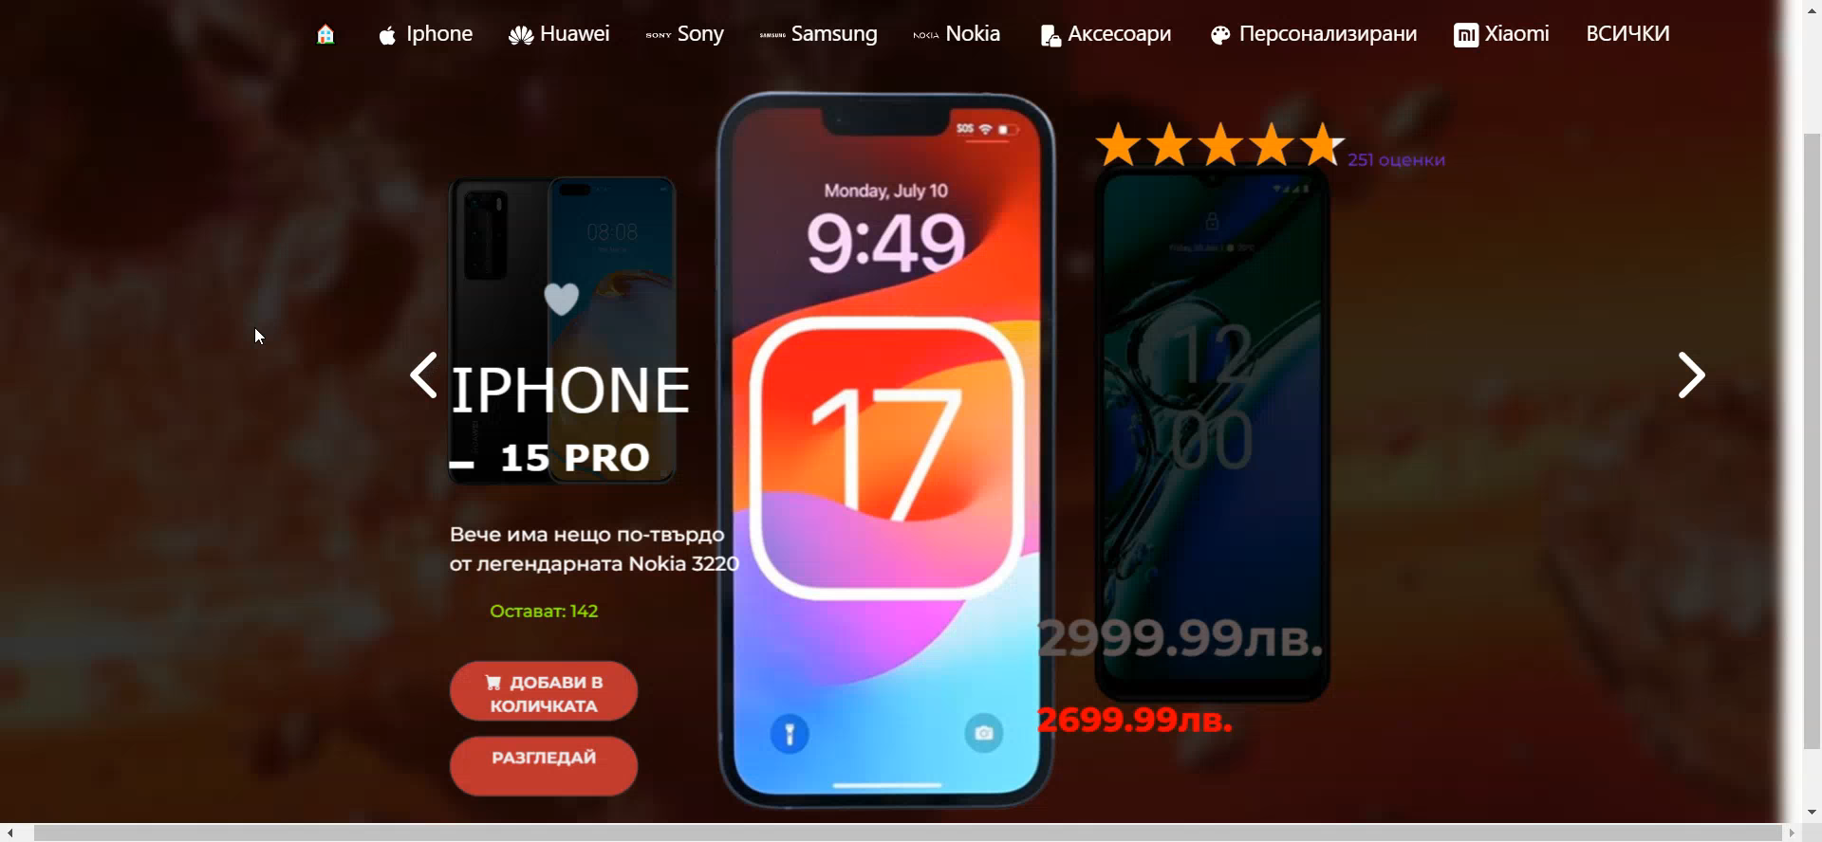
Notes:
"You" style – create a cozier feeling for the buyer The old price is shown only if it was higher than the current one In-stock items are only shown if they are below 150 Heart effects, events, button colors, and accents

Slide 19
User Experience
Reduced uptime
Translating the content
Profile customization
Search and add items to the cart
Notes:
Creates comfort Hectic everyday life Frequent redirecting is avoided Retrospection – language barrier Overview of promotional goods Arrangement and grouping of products LATEST: Event Demo

Slide 20
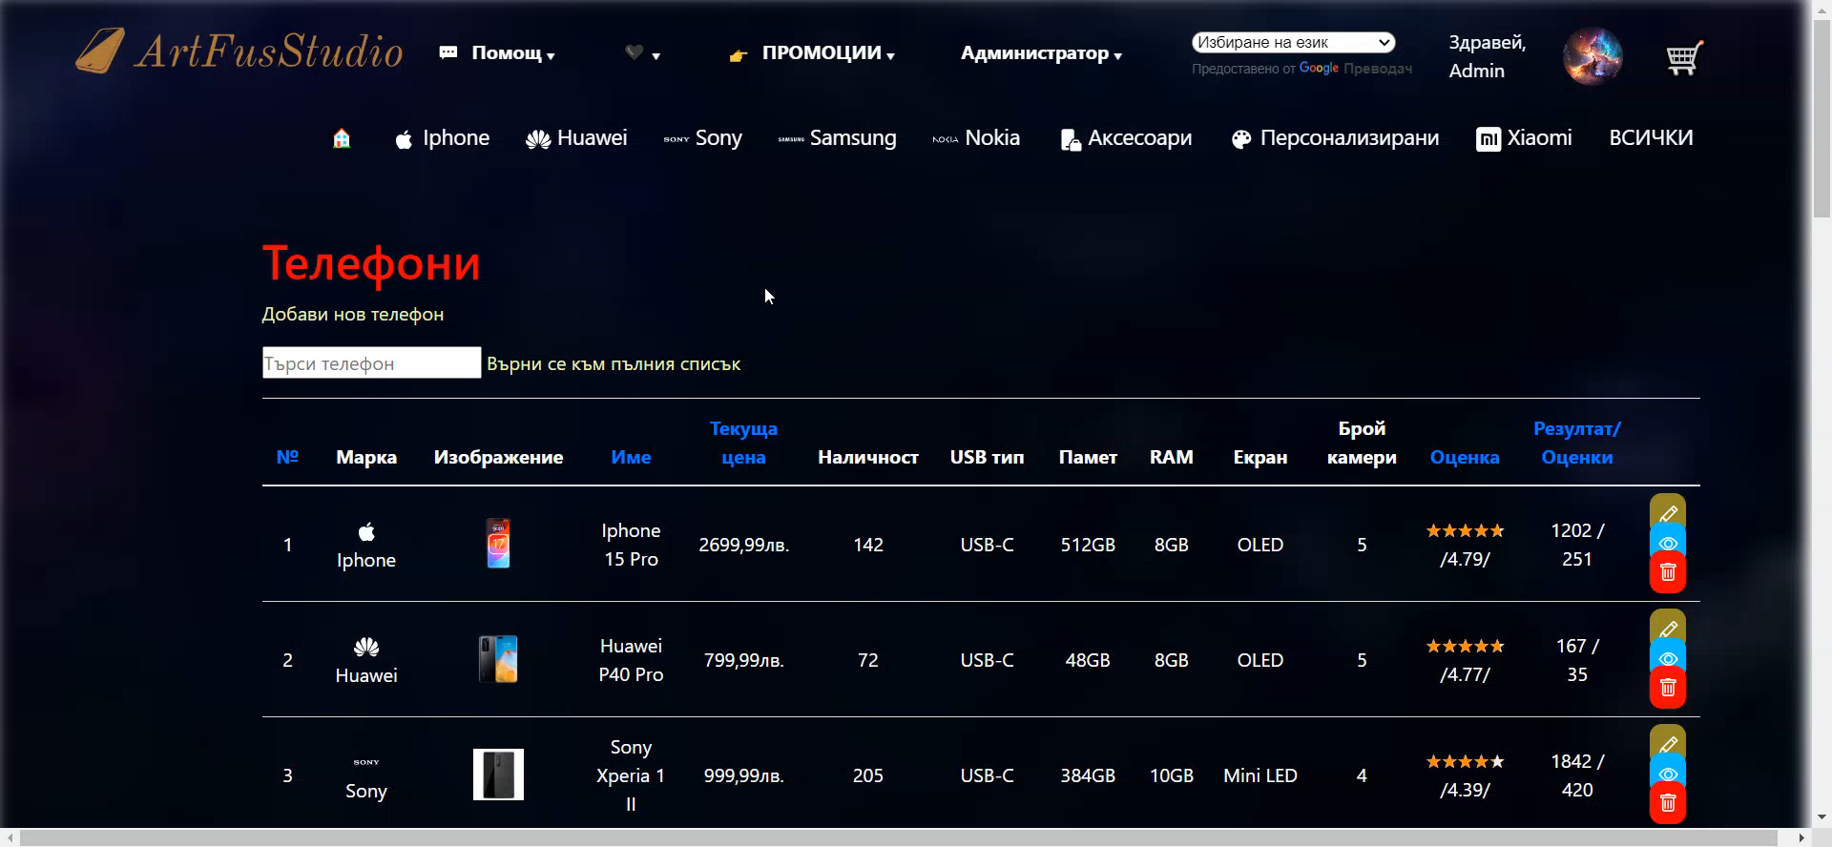
Notes:
Profile picture For translation when changing pages – extensions do not offer it Search time decreases exponentially

Slide 21

Improvements in the future
Payment system
Improving security
App Adaptability
Product reviews and ratings
Save your favorite items
Publishing and promotion
Notes:
Technologies are increasing and upgrading, and with them their vulnerabilities Retrospective: Diversity of Resolutions Adding trust to products

Slide 22

Notes:
Thank you for your attention! I look forward to your questions.

